Slide 1
PRODUCT
MANAGERS
Women in Tech:
Lin Finnegan

Slide 2
Role Description
Product managers are responsible for the release, development, advertisement, marketing, and growth of their company’s product. They are able to estimate, strategize, and research their industry to plan everything from release dates, demand of a product, potential customers, to when an upgrade their product will be required. They lead and allow for communication between all the teams involved for producing their product, including the sales, marketing, and telecommunications departments.

Slide 3
Education & Experience
TYPICAL EDUCATION REQUIREMENTS:
Product managers must typically have a:
bachelor's degree in a business, marketing, communications, economics, statistics or a related field at the very minimum
OTHER EDUCATION REQUIREMENTS:
Product managers working in a less common field may need:
additional degrees in agriculture, technology, design (UI/UX), engineering, code and more
In some smaller companies a product manager may not need a degree while a product manager in larger companies may need additional degrees.

Slide 4
Skills Required
Product Managers must:
Have excellent leadership and time management skills
Be confident and show empathy
Able to analyze data and work under stress
Know about marketing and business tactics
Additional knowledge such as having a background in technology, software engineering is also recommended but not required.

Slide 5
Average Yearly Salary: NYC (USD)
Low: 72K
Medium: 107K
High: 140K
Average: 106,587K
(2% below national average)
Additional Compensation (Cash):
Low: 3,977
Medium: 18,295 Average: 12,432 High: 32,613
The salary of a product manager is also determined by background, years worked, and past products sold.

Slide 6
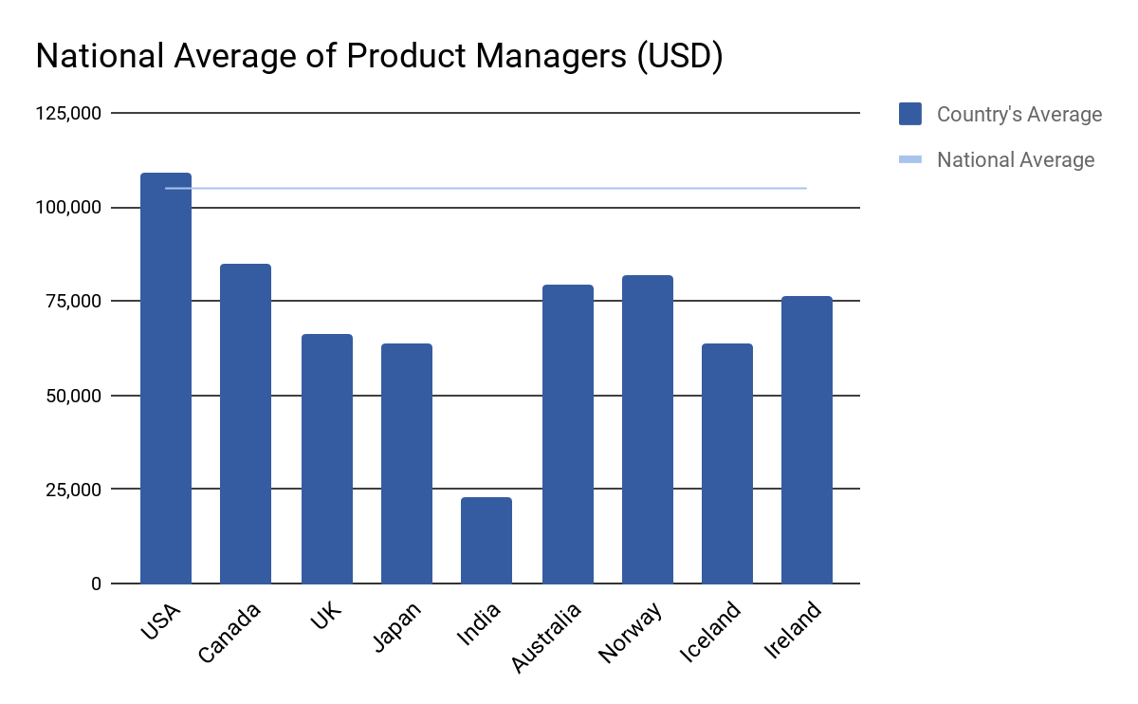
Average Salary Global Comparison

Slide 7
Pros & Cons
Can take creative and intellectual liberty on advertisement, product development, etc.
Work with a group of others for a common goal
Customer interactions allow the product to grow and for other opportunities
Budget, technology, time, resource, and other limits
Have to work under stress
Hard to focus on what the consumers want when the manager focus on minor imperfections
Must accept not having full control over your product/the market
7

Slide 8

Inspiring Leader:
Julie Zhuo
Julie Zhuo has had numerous professions, including being a product manager. She has written about her experience in articles and even in her book, “The Making of A Manager”. Julie Zhuo was a VP of Design at facebook, and is a co-founder at “Inspirit”, which partners with different people and organizations to build and sell new products.

Slide 9
Citations
Alexander, Moira. “The Pros and Cons of Becoming a Product Manager.” TechRepublic, TechRepublic, 2 Apr. 2019, www.techrepublic.com/article/the-pros-and-cons-of-becoming-a-product-manager/.
Austin, Julia. “What It Takes to Become a Great Product Manager.” Harvard Business Review, 5 Sept. 2019, hbr.org/2017/12/what-it-takes-to-become-a-great-product-manager.
Julie Zhuo, www.juliezhuo.com/.
“Salary: Product Manager.” Glassdoor, www.glassdoor.com/Salaries/iceland-product-manager-salary-SRCH_IL.0,7_IN112_KO8,23.htm.
The Ultimate Guide for Product Managers. www.aha.io/roadmapping/guide/product-management/what-is-the-role-of-a-product-manager.
Wright, Vicki. “What Education Do You Need to Be a Product Manager?” Work, 4 Apr. 2017, work.chron.com/education-need-product-manager-2487.html.
Slides Template from: Slides Carnival

